Slide 1
27th October, 2019 Butterworth Gospel Hall
Theme: The Christian Priesthood in Hebrews 10:19-25
I. The Character of the Christian Priesthood. Heb. 10:19-20
II. The Character of our High Priest. Heb. 10:21
III. The Conditions of the Christian Priesthood. Heb. 10:22
IV. The Commitment of Priests. Heb. 10:23-25

Slide 2
A. The Classes of Priesthood.
The Original Purpose of God. Exo. 19:5-8
a. The National Priesthood Put Away because of disobedience. Exo. 32:8-10, cf. Isa.61:6
The Other Priesthoods set up by God.
The Levitical Priesthood Set Aside, it was to be a Shadow Priesthood. Exo. 28:1, 2
The Melchizedek Priesthood Set Above Allothers founded on a Unique King-Priest, Heb. 7:1

Slide 3
B. The Constitution of the Christian Priesthood. Brethren or Who are Priests? Heb. 10:19
The Silence regarding a Special Priesthood (Clergy) in Scripture. (Eph. 4:11, 12; 2:20)
The Absence of a Special Priesthood in Scripture. (Acts 20:28; 6:1-5; I Tim.3; Tit.1)
The Presence of the Christian Priesthood in Scripture or Who are Constituted Priests?
All who are Believers in Christ. I Pet. 2:1-9
All who are Brethren of Christ. Heb. 10:19

Slide 4
C. The Confidence in the Christian Priesthood. Heb. 10:19 Having therefore, Brethren, Boldness to enter into the holiest by the Blood of Jesus…
1. This Boldness is Objective. Heb. 9:14
The Boldness is Positive. Heb. 9:14 – purge (lit. = scrub) your conscience
It is not based on Feelings – Ct. The Role of Conscience.
It is not based on Failures – from dead works
But it is based on Faith.

Slide 5
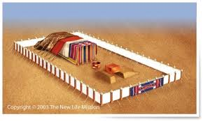
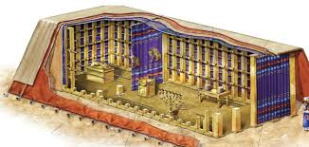
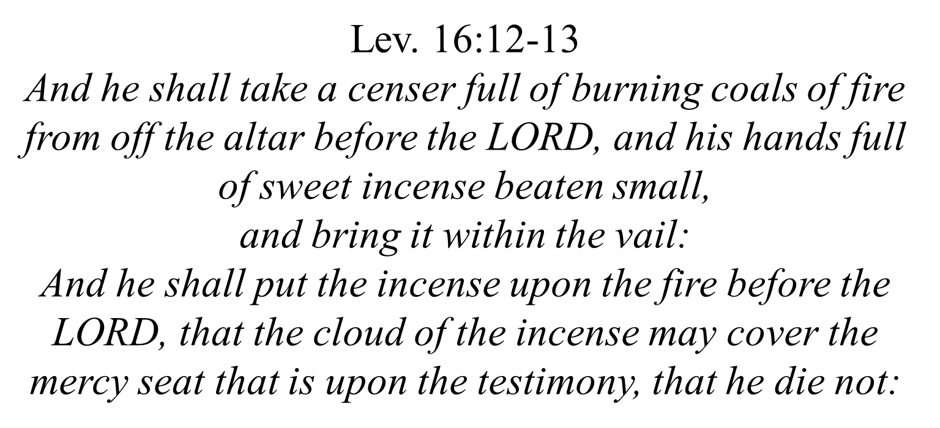
Pt. 1b – D. The Consecration of the Christian Priesthood. Heb. 10:19 to enter into the Holiest…
Hebrews 9:1-5 1 Then verily the first covenant had also ordinances of divine service, and a worldly sanctuary. 2 For there was a tabernacle made; the first, wherein was the candlestick, and the table, and the shewbread; which is called the sanctuary. 3 And after the second veil, the tabernacle which is called the Holiest of all; 4 Which had the golden censer, and the ark of the covenant overlaid round about with gold, wherein was the golden pot that had manna, and Aaron's rod that budded, and the tables of the covenant; 5 And over it the cherubims of glory shadowing the mercyseat…
1. The Structure of the Tabernacle. Heb. 9:1-5
a. The Three Compartments in their typical teaching. Cp. Heb. 8:5; 9:11, 23
The Outer Court: Calvary, where Christ died.
The Holy Place: the Heavens through which Christ passes. 9:24
iii. The Holiest: the Presence of God. 9:24
Hebrews 9:24
For Christ is not entered into the holy places made with hands, which are the figures of the true; but into heaven itself, now to appear in the presence of God for us:

Slide 6
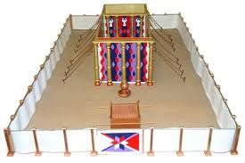
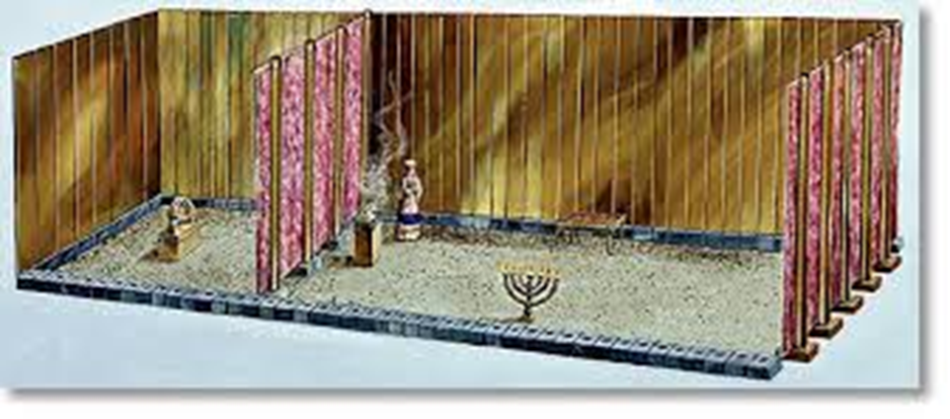
D. The Consecration of the Christian Priesthood. Heb. 10:19
The Structure of the Tabernacle. Heb. 9:1-5
The Three Compartments in their typical teaching. Cp. Heb. 8:5; 9:11, 23
The Three Curtains (Veils) 9:6-9
The Gate of the Outer Court (20 x 5 cubits): Salvation.
The Door of the Tent (Tabernacle, 10 x 10 cubits): Service.
The Veil (10 x 10 cubits): Spiritual worship

Slide 7
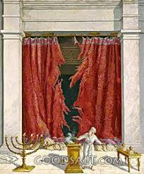
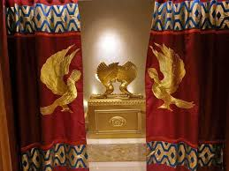
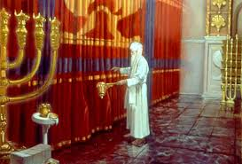
2. The Standing of the Veil.
a. It kept God’s Presence In.
b. It kept God’s People Out.
i. “new” – a newly-slain lamb ct. the old slain goat of the earthly tabernacle. Lev. 16:14
ii. “living” – in contrast to the dead sacrifices, and the dead road, and the dead results.
iii. “way” – i.e. through the Veil…His flesh.

Slide 8
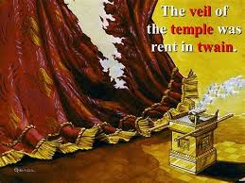
3. The Significance of the Rent Veil. An uncrucified Saviour is no Saviour.
a. The Removal of Distance.
i. The Jews worshipped afar off. Exo. 24:1, 2
ii. The Gentiles were afar off. Eph. 2:13

Slide 9
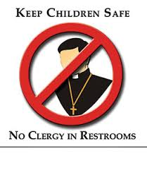
iii. But, the Church is made near Eph. 2:13 And Christians are to draw near Heb. 10:2
Under the Law ct. Under Christ
Distance between Man and God is Removed – a New Way. Jn. 4:23, 24
Beware of False Worship – 4:22a
Beware of Figurative Worship – 4:22b
What we need is Faithful Worship – 4:23, 24
Distance between Jew and Gentile is Removed – a New Body. Eph. 2:16; Gal. 3:28
Hence, no Clergy

Slide 10
3. The Significance of the Rent Veil. a. The Removal of Distance.
b. The Removal of Demarcation – the new and living way Heb. 10:20, 19
i. Where Approach can be made at all times. 4:16
ii. Where Access is granted to all Priests. Eph. 2:18
Made such by the Blood of Christ. Heb. 10:19
Made such by the New Birth. I Pet. 2:5, 9
iii. Where Acceptance is because of the Once-for-All Sacrifice. Heb. 10:14, 15

Slide 11
Conclusion: Beware of the Barrier of…
(1) Ritualism in the hierarchy. Eph. 2:15
(2) Riches in society – by the cross 2:16
(3) Religiousness in piety – circumcision. 2:11
(4) Racism in the Community – Gentiles 2:11 the Cross grants equality to all.
(5) Rites Raised in priestly ministry – the holiest (lit. = the holy places) Heb. 9:6-11ff

Slide 12
When Christ’s work was completed – It is Finished!
the Veil rent,
the Holy Place and the Holiest were united
and made one Sanctuary.
Thus, Worship and Service go together. Rom. 12:1, 2; Heb. 12:27, 28
What God has Pulled down,
Let no Man Put up.

Slide 13
27th Oct., 2019 Butterworth Gospel Hall
Theme: The Christian Priesthood in Hebrews 10:19-25
I. The Character of the Christian Priesthood. Heb. 10:18-20
In 2020, D.V.
The Character of our High Priest. Heb. 10:21
III. The Conditions of the Christian Priesthood. Heb. 10:22
The Commitment of Priests. Heb. 10:23-25
Next Meeting: The Year of the Rat – 19 Jan. 2020

Slide 14
Acknowledgement: Many images in this Presentation are sourced from the Internet with the sole intention of illustrating my biblical teaching and not used for any profitable purpose. Note: These images are only illustrations, not necessarily authoritative.
For those interested in… Viewing the Powerpoint Presentation again;
Listening to the Study again
And/Or Want a full Outline of the Study,
Please visit (after Tuesday):
www.berita-bethel-ung.com

